Slide 1

Casual vs. member users of CYCLE
PRESENTED BY : MOHD ASIF TAJ
DATE : 1/5/2022

Slide 2
contents
About the Company​
Introduction
Objective​
Data Sources
Data Cleaning
Data Manipulation
Number of casual and member riders
Number of riders by weekdays
Number of riders by month
Average usage in minutes by weekdays
No. of bikes not returned in 24 hours
Top 10 station by number of riders
Key takeaways
Recommendations

Slide 3
ABOUT THE COMPANY
In 2016, Cyclistic launched a successful bike-share offering. Since then, the program has grown to a fleet of 5,824 bicycles that are geo-tracked and locked into a network of 692 stations across Chicago. The bikes can be unlocked from one station and returned to any other station in the system anytime.

Slide 4
INTRODUCTION
Cyclistic users can be classified into two groups casual and members.
Customers who purchase single-ride or full-day passes are referred to as casual riders.
Customers who purchase annual memberships are Cyclistic members.

Slide 5
objective
To analyze the data and find how differently casual and member riders uses the cycle.
To find how and why to market membership to the casual users of the cycle service.

Slide 6
Data sources
Data is collected directly from the company website.
Data is available at following link
https://divvy-tripdata.s3.amazonaws.com/index.html
License to use data is available at https://www.divvybikes.com/data-license-agreement.
The data is from April 2020 through April 2022

Slide 7
Data cleaning
Initially the total data contain 9.57 million rows and 13 columns.
All the null values and all the ride which last only for 60 second and below it are removed from the dataset. Bikes that were simply docked for multiple days were removed.

Slide 8
DATA MANIPULATION
Ride id, station_ids column and all the latitude and longitude column are removed from the data as it is not useful for our analysis.
All the data was arranged and organized by rider type (member or casual).
Three column were added to the dataset. Columns are weekday name, ride length in hour and in minutes.
Ride length was calculated in hour and in minute by taking difference between start and end timestamps.

Slide 9
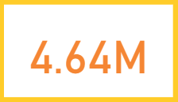
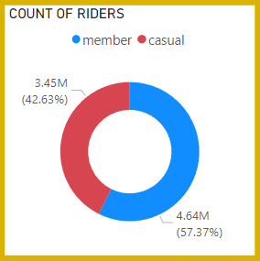
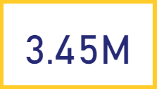
NUMBER OF CASUAL AND MEMBER RIDERS
TOTAL MEMBER RIDERS
From almost 8.09 million riders 3.45 million rider are casual riders and around 4.64 million riders are member which is approximately 1.19 million more than the casual riders
TOTAL CASUAL RIDERS

Slide 10
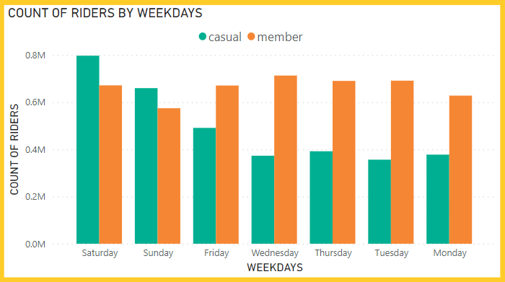
NUMBER OF RIDERS BY WEEKDAYS

Slide 11
NUMBER OF RIDERS BY WEEKDAYS
Casual riders took more rides than the members
Casual riders mostly use cycle on weekends. This is because they use it for get around town on their days off.
Member riders use cycle mostly on the weekdays. Maybe a good explanation for this is that they use bikes to reach to work and come back home.

Slide 12
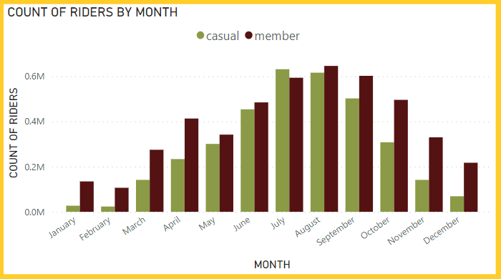
NUMBER OF RIDERS BY MONTH

Slide 13
NUMBER OF RIDERS BY MONTH
Huge amount of Cycle are used in the month of July, August and September (3rd quarter).
The no of riders are increasing sharply from February to August and start decreasing afterward.
No of rides taken by casual riders are 1.75 million and members took 1.84 million rides which is around 90,000 more than the casual users.

Slide 14
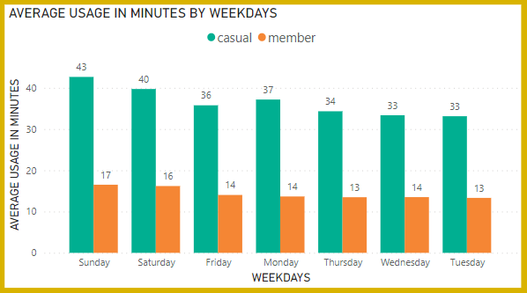
AVERAGE USAGE IN MINUTES BY WEEKDAYS

Slide 15
AVERAGE USAGE IN MINUTES BY WEEKDAYS
On an average Casual member use cycles for longer duration than members.
On weekends riders use cycles for longer duration than weekdays.
On an average on weekdays casual riders use cycle for 34.8 minutes and member use it for 13.6 minutes.
The valid reason behind this short duration for members can be that they don't want to be late for the work.

Slide 16
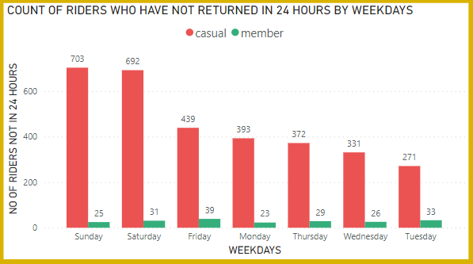
NO. OF BIKES NOT RETURNED IN 24 HOURS

Slide 17
NO. OF BIKES NOT RETURNED IN 24 HOURS
Despite the large user of cycle members return the cycle to the docking station on time.
On weekends the large no of casual riders donot return bikes in 24 hours.
Approx. ratio between casual and member riders is 15:1 when it is comes to returning the cycle in 24 hours.

Slide 18
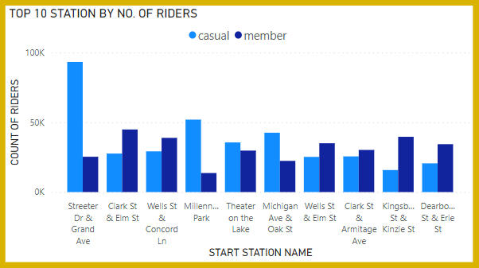
TOP 10 STATION BY NUMBER OF RIDERS

Slide 19
TOP 10 STATION BY NUMBER OF RIDERS
Overall most busiest station is Streeter Dr & Grand Ave.
Clark St & Elim St is favourite station among members.
Favourite station of casual riders is Streeter Dr & Grand Ave.
Second busiest station is Millennium Park with respect to casual riders.

Slide 20
KEY TAKEAWAYS
Maximum users of cyclistic company are casual rider.
Casual users are more active on the weekends and members are active in weekdays.
People uses bike in quarter 3 in huge numbers.
Member riders uses cycle for small duration than casual riders despite members take more rides.
Members are more responsible toward returning the cycle in 24 hours and take more care of cycle.
Streeter Dr & Grand Ave and Millennium Park are more busier station with respect to casual riders

Slide 21
RECOMMENDATIONS
Introduce the weekend passes at less price than other passes at the station from where the casual riders take more rides. Like Streeter Dr & Grand Ave and Millennium Park station will be better option for weekend passes.
Advertise the offers at station and in app that says if riders will return bike in 5 hours they will get additional discount. This will reduce the damage cause by riders to the bicycle who use it for long time.
Best time to launch the next marketing campaign would be in the month of July to September.

Slide 22
THANK YOU
ANALYSED AND PREPARED BY : MOHD ASIF TAJ

